Slide 1
Project Presentation of Industry-Oriented Hands-On Experience (22CS422)
On
High Performance Rubik’s Cube Solver using
Optimized Search Algorithms
Ravneet Kaur - 2210990720
Ansh Oberoi - 2210990138
Supervised By
Dr. Shikha Tuteja
Department of Computer Science and Engineering,
Chitkara University, Punjab

Slide 2
Introduction
The Rubik’s Cube is a classic combinatorial problem in artificial intelligence and computer science.
A standard 3×3 cube has approximately 4.3 × 10¹⁹ possible configurations, making efficient solving computationally challenging.
Traditional brute-force and exhaustive search methods become impractical due to high time and memory complexity.
Efficient solving therefore requires heuristic and optimized search techniques capable of intelligently exploring the state space.
Our work implements and compares BFS, IDDFS, and IDA* algorithms to analyze their efficiency, scalability, and performance in solving complex Rubik’s Cube configurations
2

Slide 3
Problem Statement
1. The Rubik’s Cube can be represented as a state-space search problem, where
Each cube configuration = a state
Each valid move = a state transition
2. Exhaustive or brute-force search becomes computationally infeasible due to:
High Execution Time
Excessive Memory Consumption
3. The challenge is to develop an efficient solving strategy that balances:
Time Complexity
Memory Usage
Solution Optimality
3

Slide 4
Literature Review
Early Rubik’s Cube solvers used uninformed search algorithms such as Breadth-First Search (BFS) and Depth-First Search (DFS), which guaranteed completeness but suffered from high computational and memory requirements.
Iterative Deepening Depth-First Search (IDDFS) was introduced to combine the completeness of BFS with the memory efficiency of DFS by performing repeated depth-limited searches.
Heuristic-based algorithms such as Iterative Deepening A* (IDA*) significantly improved solving efficiency by guiding the search toward promising states and reducing unnecessary exploration.
Pattern databases and heuristic optimization techniques further enhanced performance by storing precomputed heuristic values, thereby reducing search effort and improving scalability.
4

Slide 5
Objective
To design and implement an efficient Rubik’s Cube solver using optimized search algorithms.
To model the Rubik’s Cube as a state-space graph for systematic exploration of cube configurations.
To implement and analyse:
Breadth-First Search (BFS)
Iterative Deepening Depth-First Search (IDDFS)
Iterative Deepening A* (IDA*)
To identify the most efficient and scalable approach for solving complex combinatorial problems.
5

Slide 6
Algorithms Implemented
1) Breadth-First Search (BFS)
Explores all states level-by-level
Guarantees shortest path solution
Requires high memory due to storage of all generated states
2) Iterative Deepening DFS (IDDFS)
Combines BFS completeness with DFS memory efficiency
Performs repeated depth-limited searches
Reduces memory consumption significantly
3) Iterative Deepening A* (IDA*)
Uses heuristic function to guide search
Explores only promising states
Reduces execution time and memory usage significantly
Most efficient for higher-depth solutions
6

Slide 7
Methodology
The methodology of this work is based on modeling the Rubik’s Cube as a state-space graph, where each configuration represents a node and each valid move corresponds to a transition between states.
A compact cube representation is used to reduce memory usage and enable faster state comparisons.
BFS performs level-wise exploration to guarantee optimal solutions, while IDDFS reduces memory usage through depth-limited searches.
IDA* incorporates a heuristic function to guide the search towards promising states, significantly reducing the number of explored configurations.
Input Cube → State Representation → Apply Algorithm → Solution Output
7

Slide 8
Experimental Setup
1. Development Environment
Programming Language: Java
IDE Used: IntelliJ IDEA / Eclipse / VS Code
Platform: Java Development Kit (JDK)
2. Cube Configuration
Standard 3×3×3 Rubik’s Cube
Cube modeled as a state-space graph
3. Evaluation Process
Multiple test cases executed for each scramble depth
Performance analyzed across increasing complexity level
8

Slide 9
Results
1) Performance Evaluation -
Performance evaluated using execution time, memory usage, and solution efficiency
Algorithms tested across increasing scramble depth (3–10)
2) Key Observations –
BFS :
Fast at lower depths.
Fails beyond depth 7 due to exponential memory growth
IDDFS :
Reduces memory usage.
Slower due to repeated state exploration
9

Slide 10
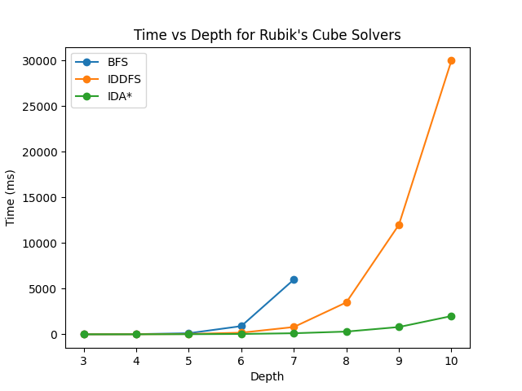
Results
IDA* :
Uses heuristic pruning
Explores fewer states
Performs efficiently even at higher depths
3) Execution Time vs Scramble Depth:
10

Slide 11
Comparative Analysis
The analysis highlights the strengths and limitations of each approach in solving complex Rubik’s Cube configurations.
The comparative results demonstrate how heuristic-based optimization significantly improves search efficiency and overall performance.
Algorithm | Time Efficiency | Memory Usage | Scalability
BFS | Moderate | Very High | Poor
IDDFS | Slow | Moderate | Average
IDA* | High | Low | Excellent
11

Slide 12
Conclusion
This work implemented and compared BFS, IDDFS, and IDA* algorithms for solving the Rubik’s Cube.
BFS guarantees optimal solutions at lower depths but suffers from excessive memory consumption as complexity increases.
IDDFS improves memory efficiency; however, repeated depth-limited searches increase execution time.
IDA* achieves the best overall performance by using heuristic-guided pruning to reduce unnecessary state exploration.
Experimental analysis shows that IDA* is the most efficient and scalable approach for solving higher-depth Rubik’s Cube configurations.
12

Slide 13
Thank You
13

